Slide 1
G.L.A.P.S
Geographic Location Attribute
Predictor System

Slide 2
Backend Team
-Mallory Milstead
-Gabriela Canjura

Slide 3
The problem
How will new structures or facilities effect property values in an area?
As a home owner would it be beneficial or detrimental to my property values to have a particular facility built in my area?
As a city or town how will this effect our constituents?

Slide 4
GLAPS
Our software predicts the effects of professional baseball stadiums on property values. Using an address and current home value our API returns a prediction of the median home value with a stadium, without a stadium and uses the percent of change to calculate the user’s home value.

Slide 5
Software
Language:
- Python
Database:
- Sqlite
Machine Learning:
- Keras backed with TensorFlow
Visualization:
- Facets
- TensorBoard
Hosting:
-PythonAnywhere
Notes:
Transition here by saying something like “Now we’ll walk you through our process”. (MALLORY)

Slide 6
Data Collection
Our data was obtained by using the Census API
Sample Call:
url = requests.get("https://api.census.gov/data/2011/acs/acs1?get=NAME,B01001_001E&for=county:*&in=state:*&key=c64b663f57b72887707719c1318350c2fb6f9146")
Visualization of the Data was achieved through the use of Google Facets.
Notes:
Login to glaps live prior to this (go to page and show facets) (MALLORY)

Slide 7
Machine Learning
In a very layman manner, Machine Learning (ML) can be explained as automating and improving the learning process of computers based on their experiences without being actually programmed i.e. without any human assistance. The process starts with feeding good quality data and then training our machines (computers) by building machine learning models using the data and different algorithms. The choice of algorithms depends on what type of data do we have and what kind of task we are trying to automate.
https://www.geeksforgeeks.org/ml-machine-learning/
Notes:
The computer is trying to minimize the discrepancy between the actual data and the prediction without direct programming.

Slide 8
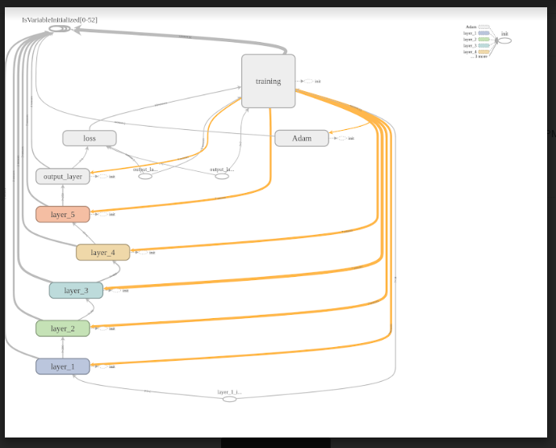
TensorBoard Model

Slide 9
Our Model
Sequential Model
Relu activation
Adam Optimizer
Notes:
(MALLORY)

Slide 10
API Creation
RESTful API
Returns JSON Dictionary
http://gmastorg.pythonanywhere.com/GLAPS?HomeVal=150000&County=Cumberland%20County,%20North%20Carolina
Notes:
(DEF OF RESTFUL API) Our webapp automatically provides the api call with the input paramaters however, if you choose to you can manually change these values. Though they must be formatted in this specific maner.

Slide 11
Going Forward
Switching from current home value predictions to future home value predictions as well as add other developmental projects such as malls, or parks.

Slide 12
WWW.GLAPS.LIVE

